Slide 1

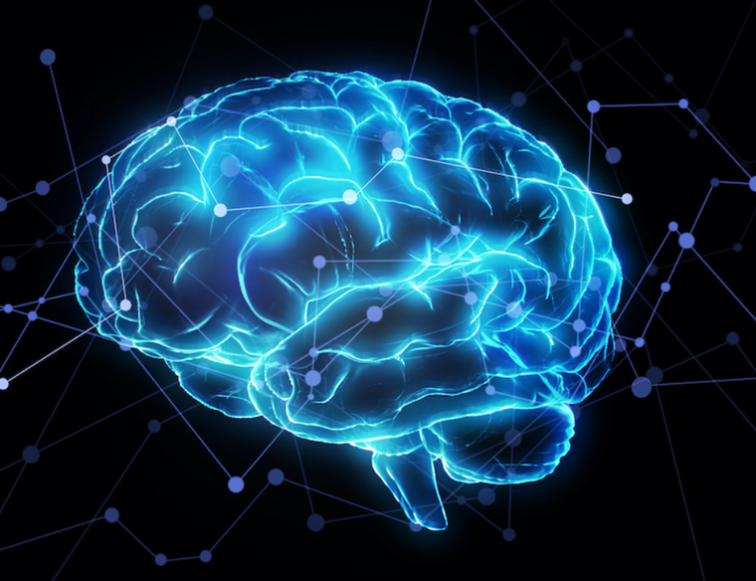
Helwan National University | Faculty of Engineering
Automated Brain Tumor
🧠
Segmentation
via U-Net Architecture
Team Members:
Saif Hany Abdel-Aziz (921220062)
Ali Ahmed Zaki (921220087)
Marwan Hassan Morsy (921220142)
Mohamed Emad Eldin (921220128)
Tasnim Ahmed Mohamed (921220037)
Dice: 0.86
IoU: 0.75
Acc: 99.7%
Supervised by: Dr. Samar M. Nour | Submission: 9 May 2026

Slide 2
The Problem
Why automated segmentation matters
Manual Segmentation Issues
Technical Hurdles
Time-Consuming
Low Contrast
Each MRI volume contains dozens of slices requiring expert review
Tumors often share similar intensity levels to healthy brain tissue
Subjective Results
Class Imbalance
Significant inter-observer variability between specialists
Tumor pixels are statistically rare vs. background pixels
Cognitive Load
💡 Solution: Deep Learning with U-Net
High-pressure settings increase the risk of missing small lesions
Automated, objective, fast segmentation at scale

Slide 3
Historical Context
The evolution of medical image segmentation
Pre-2015
2015
Innovation
🔍
🏆
🎯
Sliding Window Era
U-Net Breakthrough
Key Goals
CNNs predicted pixel labels by analyzing small surrounding patches.
Problems: Extremely slow, no global context — couldn't see the whole organ at once.
Ronneberger et al. introduced U-Net at MICCAI conference — a revolutionary modification of the Fully Convolutional Network (FCN).
Work with very few training images (a common medical challenge) while delivering high-resolution, precise output at scale.
Source: Ronneberger, Fischer & Brox (2015) — U-Net: Convolutional Networks for Biomedical Image Segmentation, MICCAI

Slide 4
U-Net Architecture
Encoder–Decoder with Skip Connections
Skip Connections
🔻 Encoder
Max pooling downsamples the image, extracting high-level semantic features
Conv 64
Conv 64
Seg
Mask
Conv 128
Conv 128
🔺 Decoder
Conv 256
Conv 256
Conv 512
Conv 512
Up-convolutions restore spatial resolution back to original image size
ENCODER (Contracting)
Bottleneck
1024
DECODER (Expansive)
↔ Skip Connections
Pass fine-grained spatial info from encoder directly to decoder

Slide 5
System Implementation
Data pipeline, loss function & evaluation metrics
📦 Data Engineering
⚖️ Hybrid Loss Function
📏 Evaluation Metrics
Input Resolution
BCE Loss
Dice Coefficient
256 × 256 pixels — balances detail & compute cost
Binary Cross-Entropy — pixel-level classification
Primary metric — degree of overlap (0–1 scale)
Augmentation
Dice Loss
IoU / Jaccard
ImageDataGenerator: rotations, shifts, zooms
Measures overlap between predicted mask & ground truth
Stricter metric — area overlap ÷ area of union
Purpose
Strategy
Pixel Accuracy
Simulate varied MRI scanner angles to prevent overfitting
Combining both overcomes severe class imbalance
% of correctly classified pixels overall

Slide 6
Training Optimization
Keras Callbacks for automated, intelligent training
# Python / Keras
⛔ Early Stopping
EarlyStop = EarlyStopping(
patience=10, restore_best_weights=True)
Reduce_LR = ReduceLROnPlateau(
monitor='val_accuracy',
factor=0.5, min_lr=0.00001)
model_check = ModelCheckpoint(
'model.keras', monitor='val_loss',
save_best_only=True)
patience=10, restore_best_weights=True
Halts training if no improvement for 10 epochs. Restores the best checkpoint — prevents overfitting.
📉 ReduceLROnPlateau
factor=0.5, min_lr=0.00001
🎯 Training Strategy
Cuts learning rate by half when accuracy plateaus, helping the model escape local minima.
Together, these three callbacks form an automated optimization loop:
→ Train until optimal → Save best state → Reduce LR if stuck → Stop early if overfitting
💾 Model Checkpoint
monitor='val_loss', save_best_only=True
Saves only the best model version. Crash-safe — the optimal weights are always persisted to disk.

Slide 7
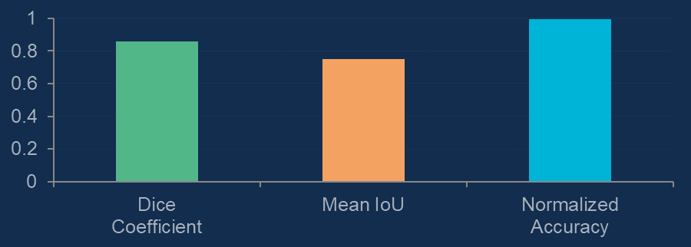
Experimental Results
Quantitative performance metrics across validation set
🏆
✅
📐
0.86
99.7%
0.75
Dice Coefficient
Pixel Accuracy
Mean IoU
Primary Overlap Metric
Correctly Classified Pixels
Jaccard Index (Stricter)
📋 What This Means
Dice 0.86 — strong clinical-grade overlap
IoU 0.75 — robust spatial boundary agreement, suitable for neurosurgical planning
99.7% Accuracy — near-perfect pixel classification

Slide 8
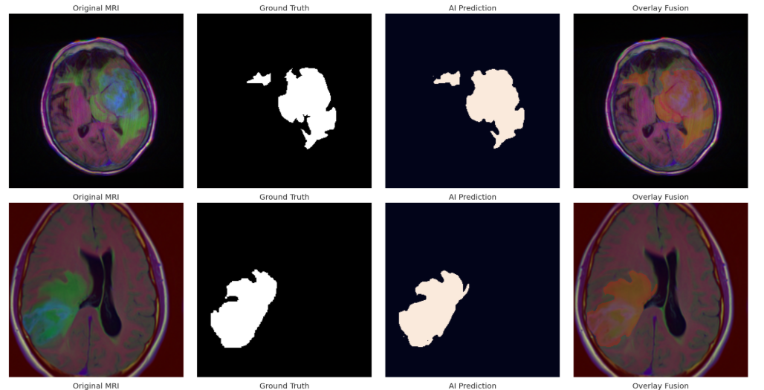
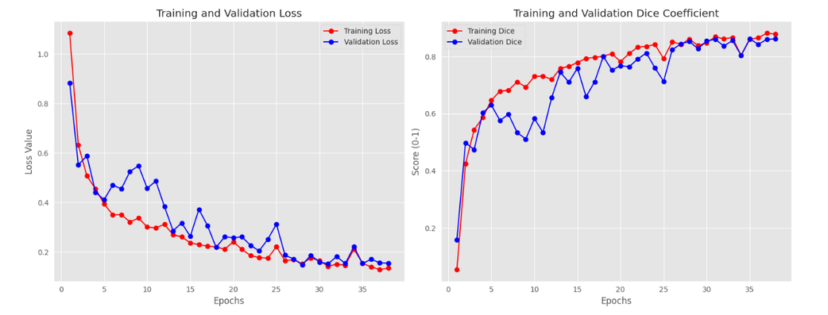
Quantitative and Qualitative Evaluation

Slide 9
Deployment Strategy
From research notebook to real-world clinical tool
1
2
3
4
🔬
⚡
🌐
🏥
Trained Model
(Kaggle)
Quantization
& Optimization
Streamlit
Web App
Clinical
Use
U-Net trained & validated, saved as model.keras (372 MB)
Model quantized for faster inference on standard hospital hardware
Python-based interactive web interface for real-time inference
Upload MRI scan → Get segmentation mask + overlay within seconds
🔑 App Features
Upload JPG/PNG/TIF MRI scans
Real-time AI segmentation
Predicted mask visualization
Overlay fusion view

Slide 10
Conclusion & Future Work
✅ Key Achievements
🔭 Future Work
Dice Coefficient 0.86
Attention U-Net
High clinical-grade tumor segmentation accuracy
Focus on smaller lesions using attention gates within encoder blocks
Skip Connections
Multi-Modal MRI
Proved essential for precise spatial boundary recovery
Incorporate T1, T2 & FLAIR sequences for richer diagnostics
Hybrid Loss Function
BCE + Dice solved the class imbalance challenge
3D Segmentation
Streamlit Deployment
Extend to volumetric MRI for full 3D tumor delineation
Bridged the gap between research and clinical practice
Thank You · Questions?
Supervised by Dr. Samar M. Nour | Helwan National University, Faculty of Engineering

